Slide 1
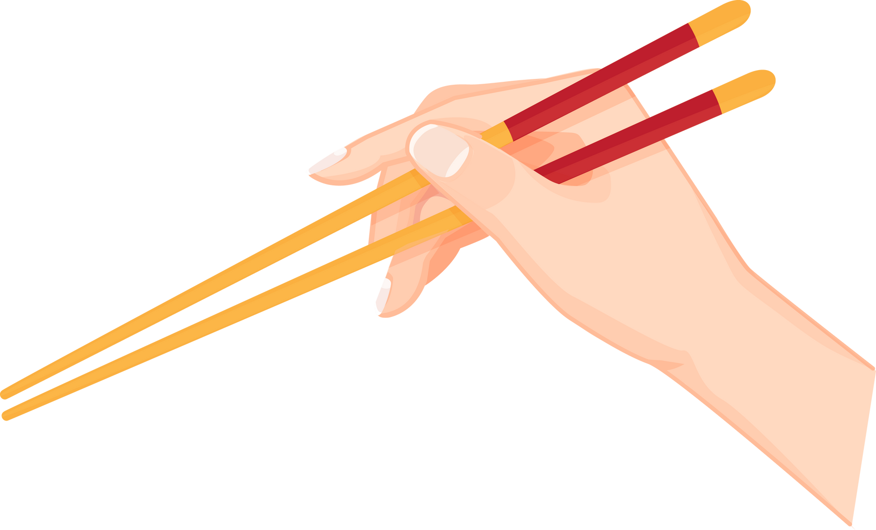


LESSON 4: WHAT TIME DO YOU HAVE DINNER?
THE CHOPSTICK GAME!

Slide 2
RULES:

Slide 3




THIS WILL BE A 1V1 TEAM GAME

Slide 4






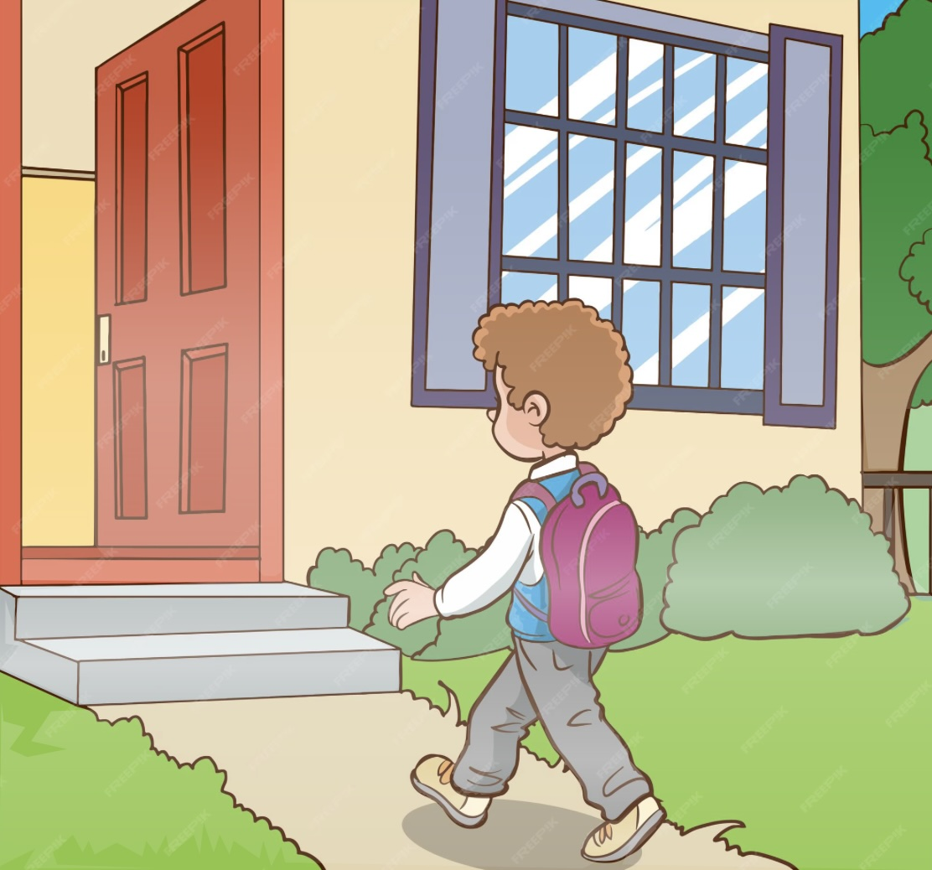

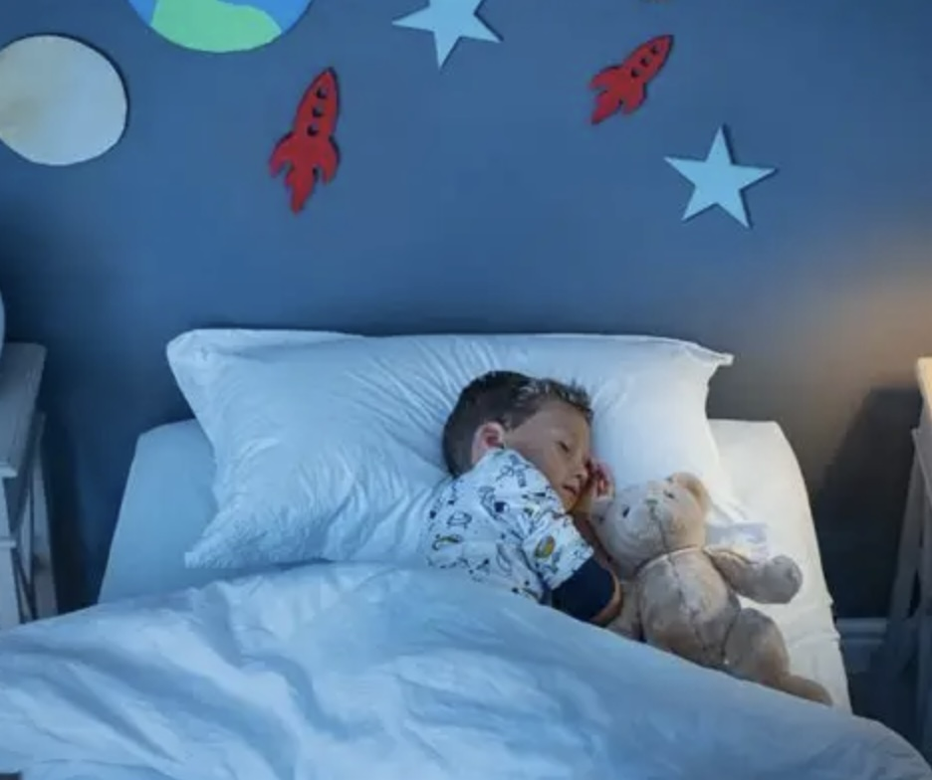

THERE WILL BE CARDS WITH EXPRESSIONS ON THEM!
7:00
8:00
6:20
4:30

Slide 5

TEACHER WILL SAY A SENTENCE!

Slide 6

TEACHER WILL SAY A SENTENCE!
What time do you get up?

Slide 7

After 3, 2, 1 GO

Slide 8




RUN TO THE TABLE!
7:00
8:00

Slide 9
PICK UP THE RIGHT CARD WITH CHOPSICKS!
7:00
8:00
6:20
4:30

Slide 10
ONCE YOU GOT IT, PUT IT IN THE BOX!

Slide 11
ONCE YOU GOT IT, PUT IT IN THE BOX!

Slide 12
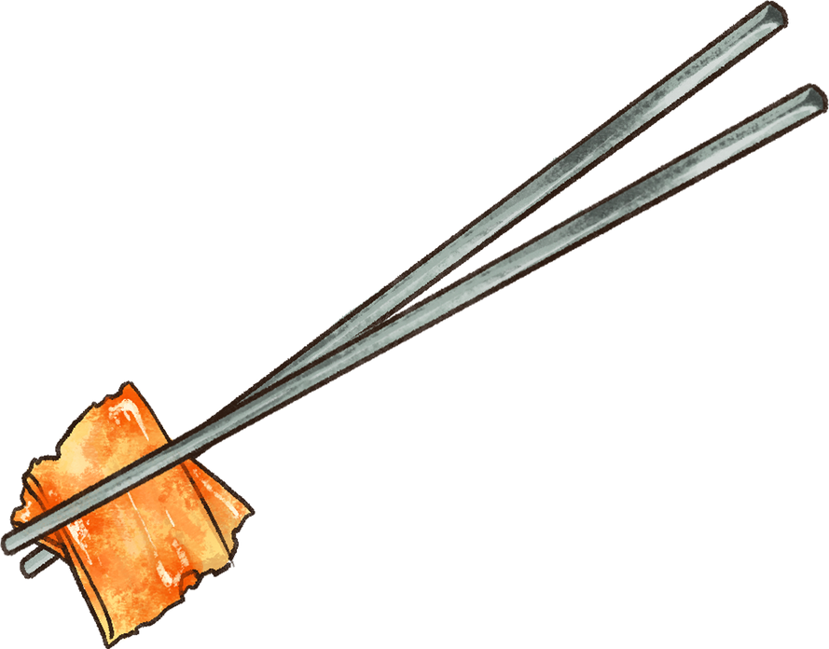

If you are correct, you get a point for your team!

Slide 13
REMEMBER!!
be careful!
no pushing!
no poking!
be nice!

Slide 14

READY?

